Slide 1
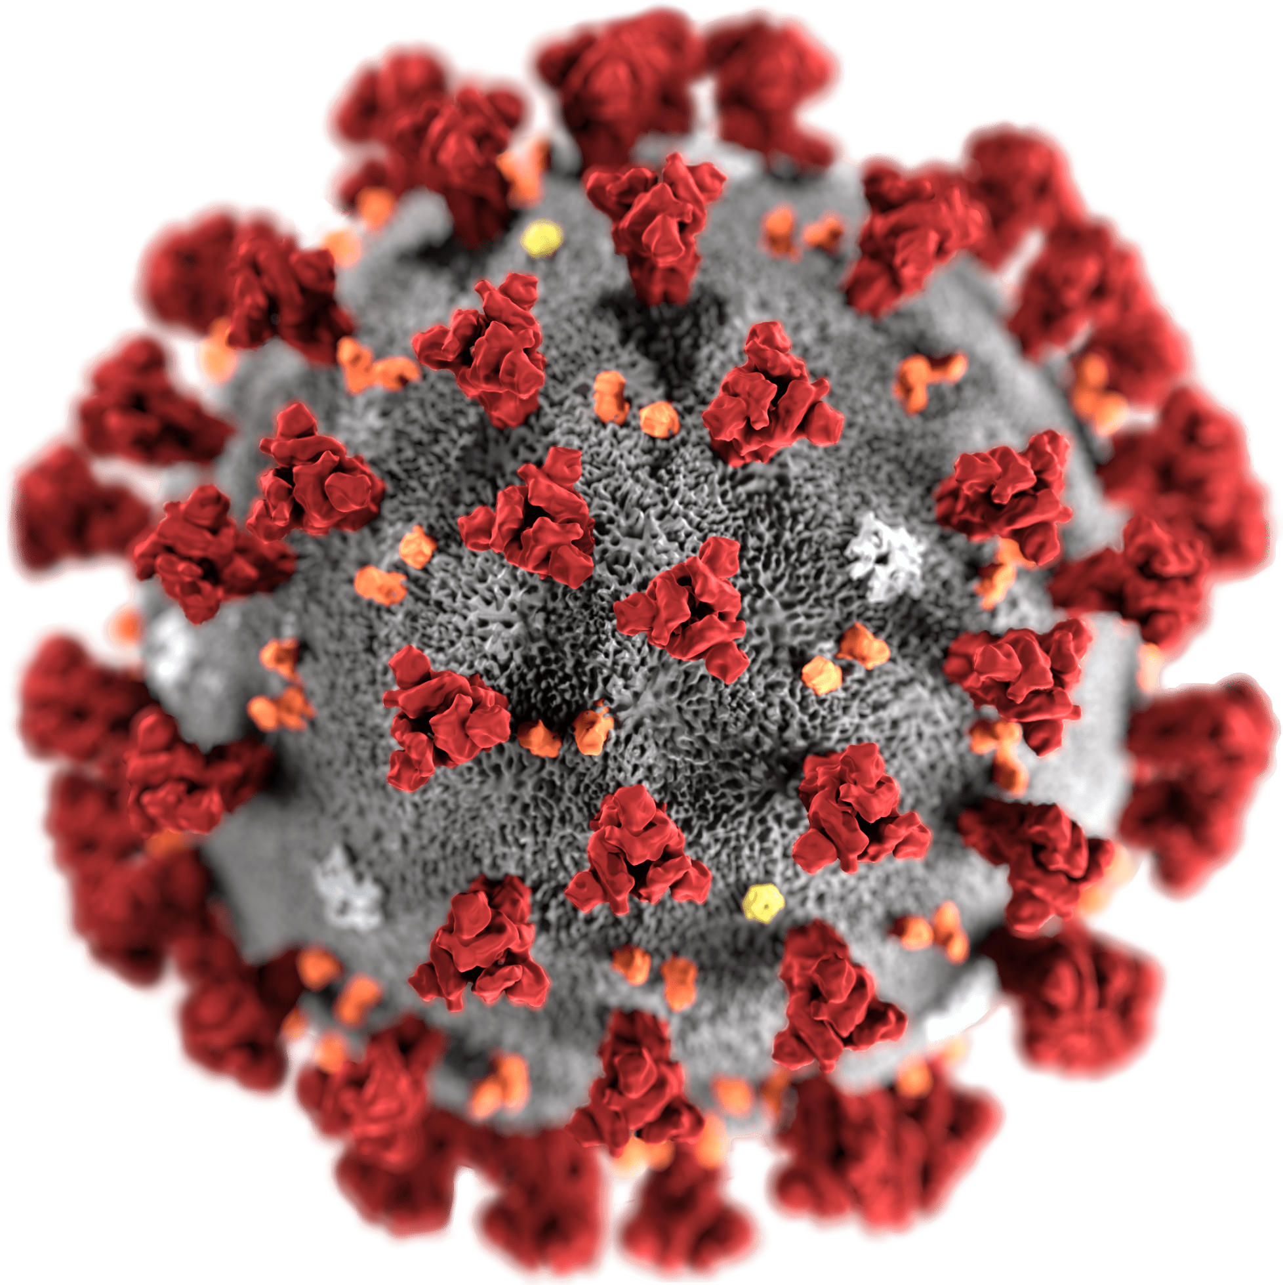
Covid-19 diagnosis using CNN
Manos Koutoulakis & Manos Markodimitrakis

Slide 2
Outline
COVID-19
Scope of this project
Dataset
Tools
References

Slide 3
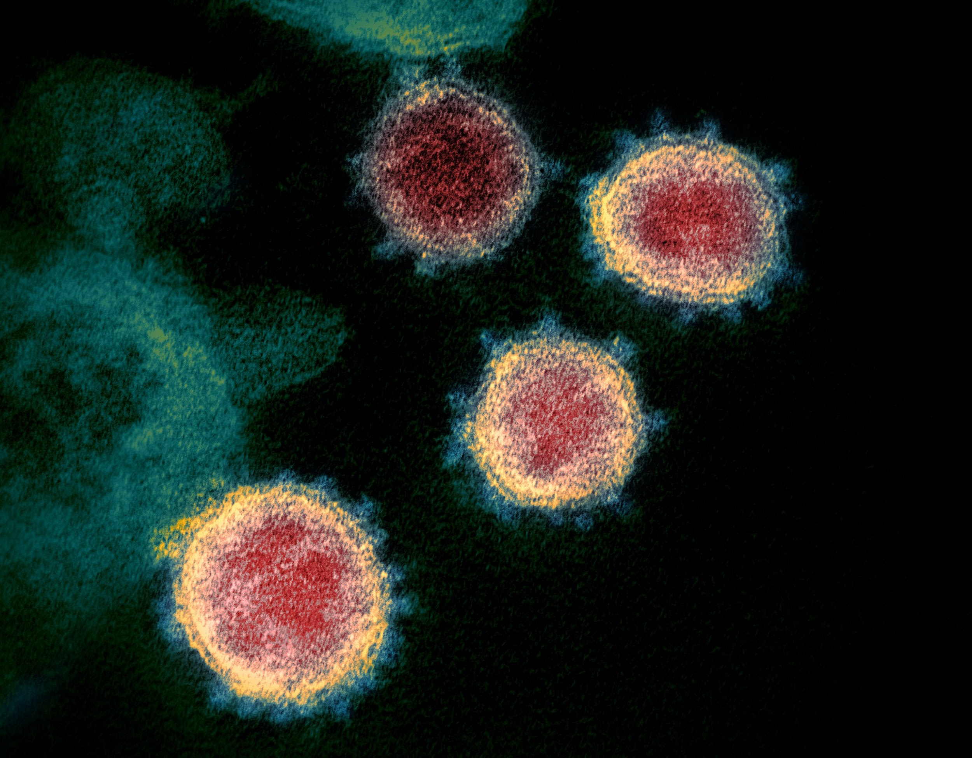
COVID-19
Coronavirus Disease 2019 (COVID-19) is an infectious disease derived from Severe acute respiratory syndrome coronavirus 2 (SARS-CoV-2).
The first case was identified in Wuhan, China in December 2019
From December 2019 until now the virus has spread all over the world
Source : https://el.wikipedia.org/wiki/COVID-19

Slide 4
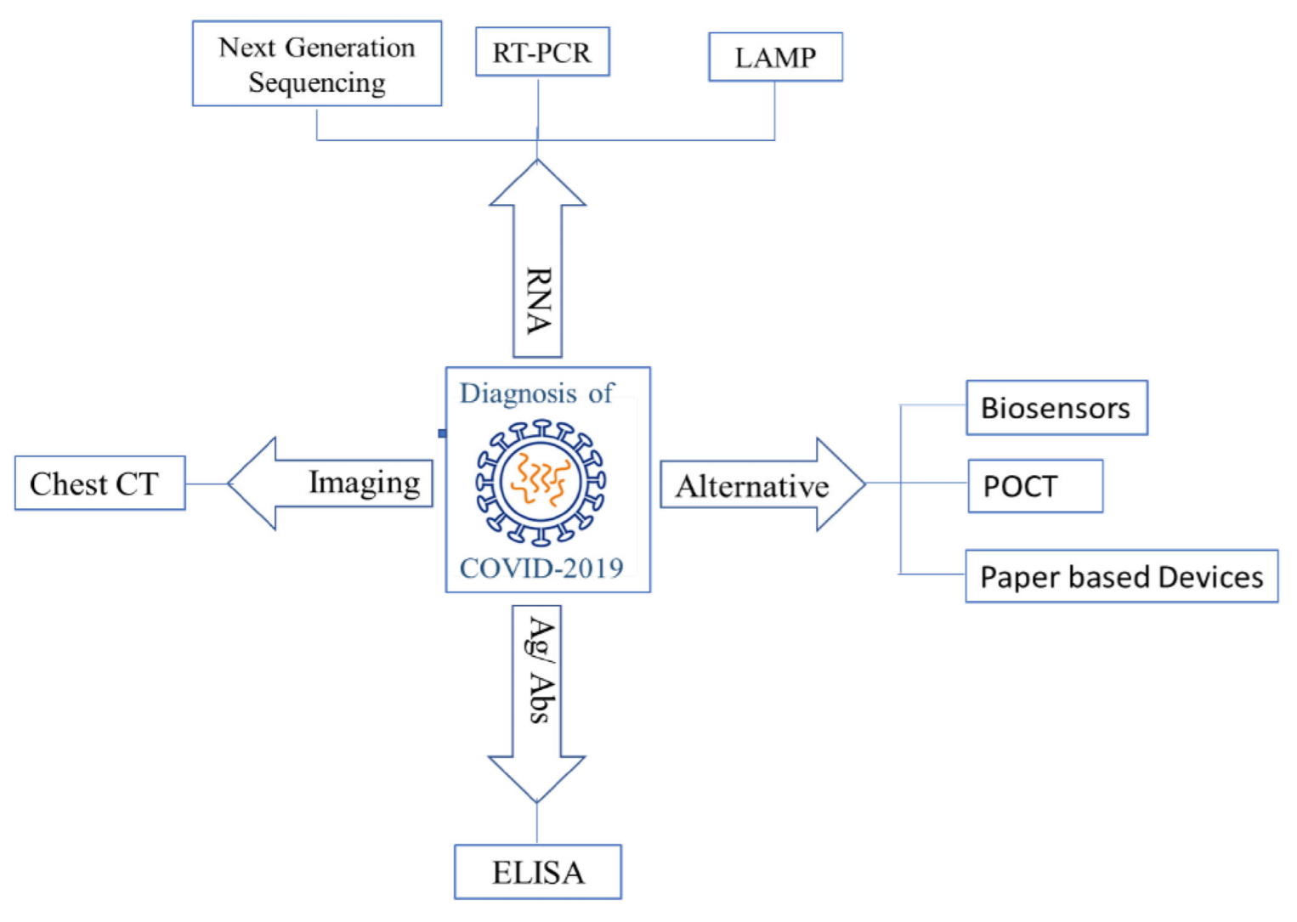
Current diagnostic approaches
Source: https://www.researchgate.net/publication/342156516_COVID-19_diagnostic_approaches_different_roads_to_the_same_destination

Slide 5
Scope of this project

Slide 6
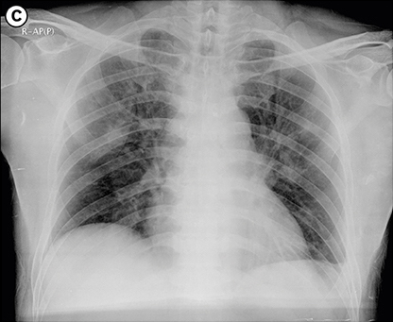
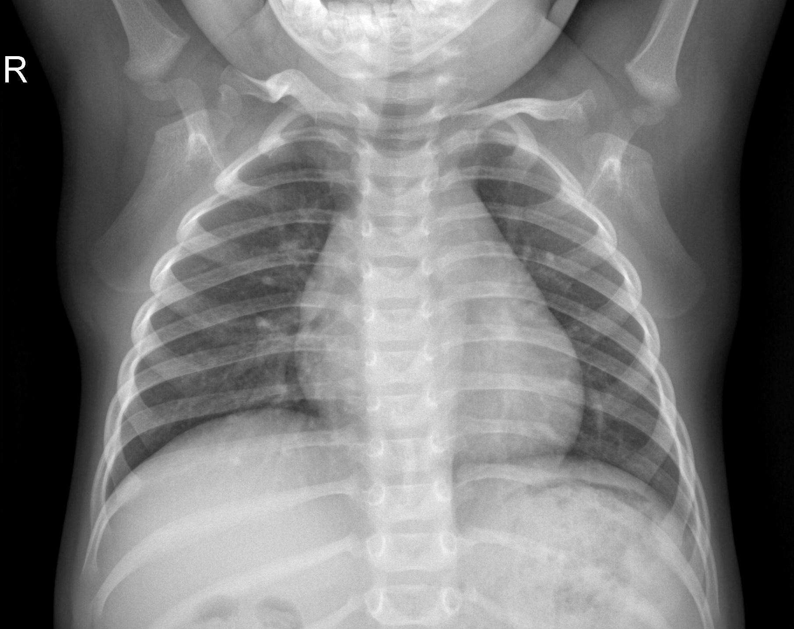
Scope
To diagnose if the patient has Covid-19 through chest Χ-ray using neural networks
Develop and improve the current deep learning approaches
Validate our results
POSITIVE
NEGATIVE

Slide 7
Dataset

Slide 8
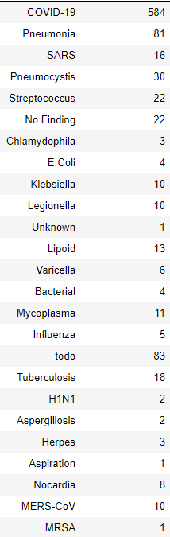
Dataset (1/2)
The dataset contains 950 patients
Each of them has their own X-Ray image
There is a wide range of viruses and bacterias in this dataset
Medical Images
Normal
Covid-19
Source: https://github.com/ieee8023/covid-chestxray-dataset
https://www.kaggle.com/paultimothymooney/chest-xray-pneumonia

Slide 9
Dataset (2/2)
Feature | Number of subjects
Sex | 870
Age | 713
Finding | 950
Survival | 361
Went ICU | 397
In ICU | 335
Needed O2 support | 90
Feature | Number of subjects
Temperature | 78
pO2 Saturation | 119
Modality | 950
View | 950
Location | 894
Filename | 950
Date | 661

Slide 10
Tools
Tensorflow
Matplotlib
Pandas
Sklearn.skimage
Keras

Slide 11
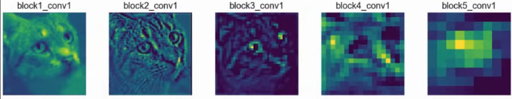


Feature extraction

Slide 12
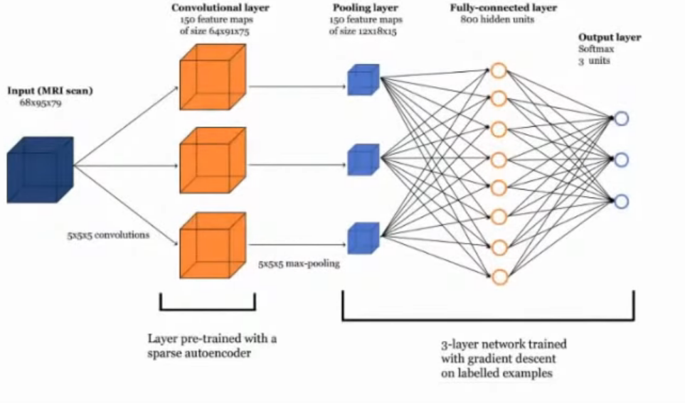
Classify the Image according to Features

Slide 13
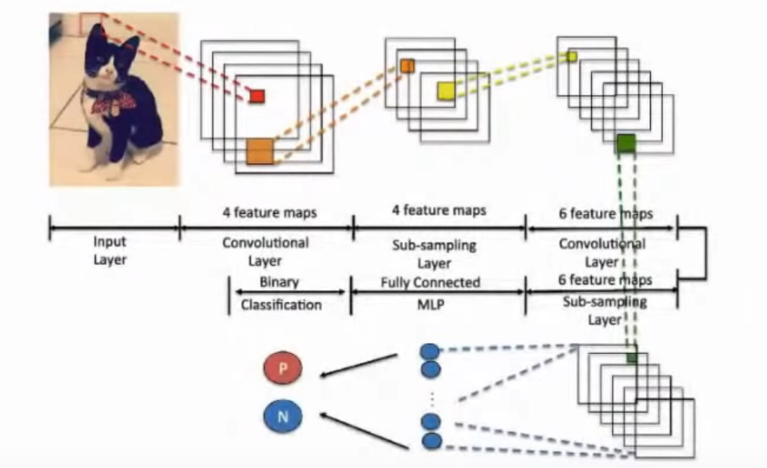
Feature extraction + Classification = CNN

Slide 14
Workflow
Data preprocessing
Model creation
Training
Validation

Slide 15
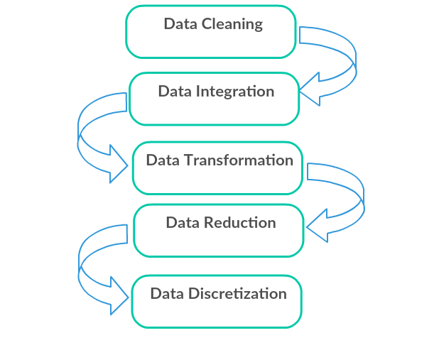
Data preprocessing

Slide 16
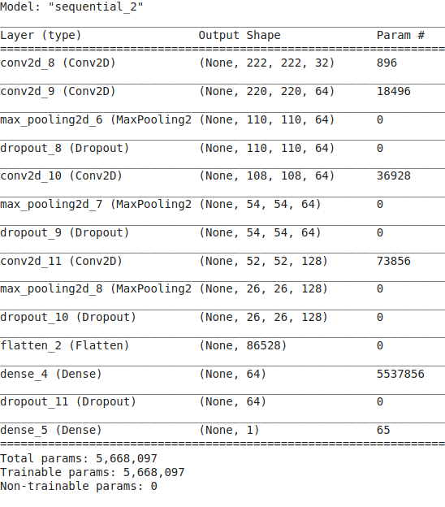
Model creation

Slide 17
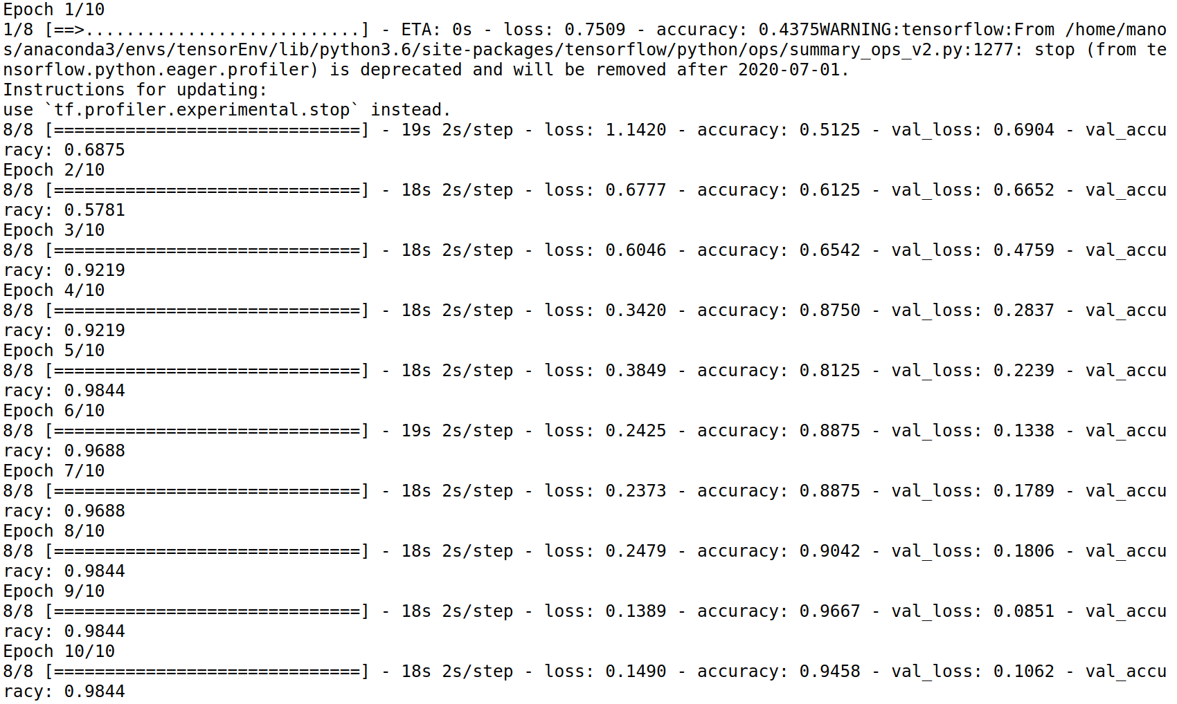
Training

Slide 18
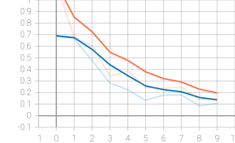
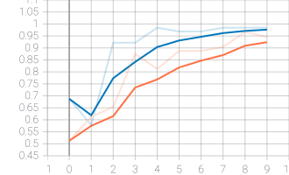
Validation(1/2)
Epoch Loss
Epoch Accuracy

Slide 19
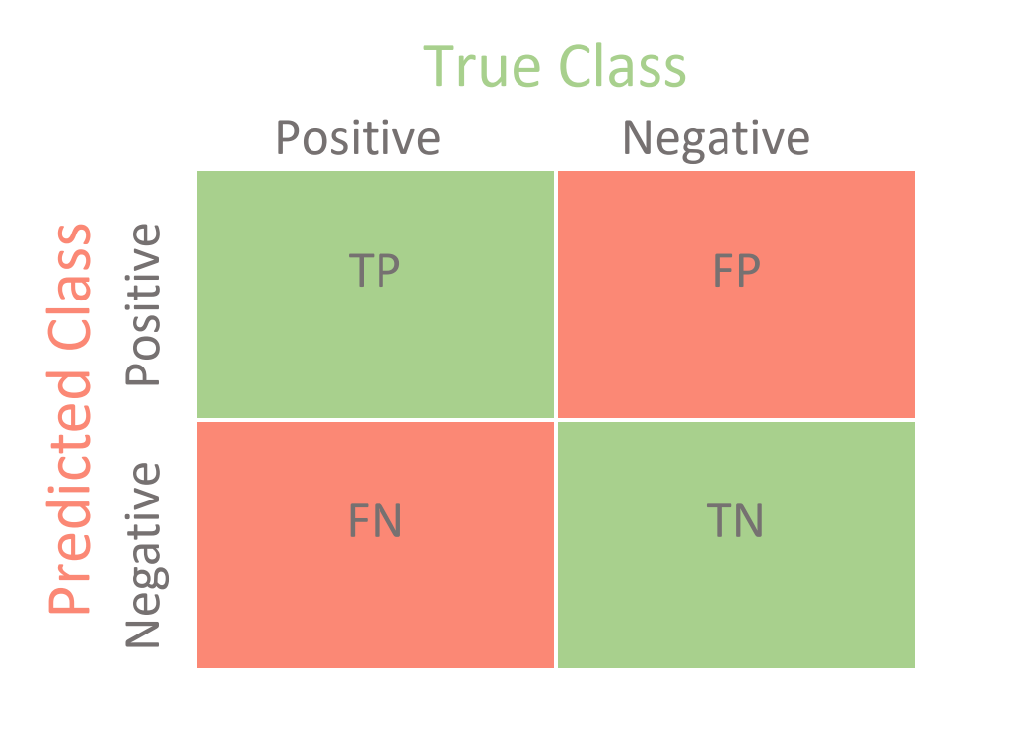
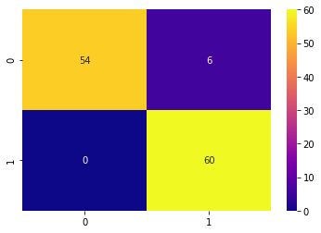
Validation(2/2) - Confusion matrix

Slide 20
References
Gianluca Maguolo, Loris Nanni, “A Critic Evaluation of Methods for COVID-19 Automatic Detection from X-Ray Images ” Sci. Data, vol. 5, no. 1, p. 180202, Dec. 2018, Cite as: https://arxiv.org/2004.12823
Brownlee J , “How to configure Image Data Augmentation in Keras”, April. 2019, Retrieved from: https://machinelearningmastery.com/how-to-configure-image-data-augmentation-when-training-deep-learning-neural-networks/
Sekeroglu, B., & Ozsahin, I., Detection of COVID-19 from Chest X-Ray Images Using Convolutional Neural Networks. SLAS TECHNOLOGY: Translating Life Sciences Innovation, 247263032095837, Sep 2020, doi:10.1177/2472630320958376
Jain R., Gupta M., Taneja S., et al. “Deep learning based detection and analysis of COVID-19 on chest X-ray images”, Appl Intell (2020), doi: https://doi.org/10.1007/s10489-020-01902-1

Slide 21
Covid-19 diagnosis using CNN
Thank you for your attention
Questions?
Manos Koutoulakis & Manos Markodimitrakis
Source Code : https://github.com/manoskout/covid-19-diagnosis-using-cnn/

